Slide 1
Age of Discovery
Spreading European Culture through out the World

Slide 2
Terms and Names
Bartolomeu Dias: Portuguese explorer who rounded the tip of Africa
Prince Henry: Portuguese supporter of exploration
Vasco da Gama: Explorer who gave Portugal a direct sea route to India.
Treaty of Tordesillas: Treaty between Spain and Portugal dividing newly discovered lands between them.
Dutch East India Company: Dutch company that established and directed trade throughout Asia.
Christopher Columbus: Italian explorer who landed in the Americas
Colony: land controlled by another nation

Slide 3
Hernando Cortés: Conquistador who defeated the Aztecs
Conquistadors: Spanish explorers in the Americas
Francisco Pizarro: Conquistador who defeated the Incas.
Atahualpa: Last Incan emperor
Mestizo: Person with mixed Spanish and Native American blood
Encomienda: System of mining and farming using natives as slave labor.
New France: Area of the Americas explored and claimed by France.
Jamestown: First permanent settlement in America
Pilgrims: Group of English people who founded a colony in Plymouth.
Puritans: People who did not agree with the practices of the Church of England.
New Netherlands: Dutch colony begun in modern New York City
French and Indian War: War between Britain and France over land in North America
Metacom: Native American leader who led an attack on villages of Massachusetts; also known as King Phillips War.

Slide 4
Atlantic Slave Trade: the buying and selling of Africans for work in the Americas.
Triangular trade: European trade between the Americas, Africa and Europe involving slaves and other goods.
Middle Passage: Voyage that brought captured Africans to the West Indies and the Americas.

Slide 5
Age of Discovery Timeline
Just like with the Reformation, there is a lot going on at once during the Age of Discovery.

Slide 7
Europeans Explore East
Why did Europeans begin to explore new lands
Two reasons for exploration
How did Portugal lead the way in exploration
How did Spain and Portugal resolve their differences
What were their differences
Who established trading empires in the Indian Ocean
How did the Dutch and English become powerful in the Indian Ocean

Slide 8
Prince Henry the Navigator

Slide 9
Bartolomeu Dias

Slide 10
Vasco de Gama

Slide 11
Ferdinand Magellan

Slide 12
Spain builds an American Empire.
How did the voyage of Columbus change the Americas.
Why did Spain conquer the Aztecs
What was the main goal for Cortés
How did Spain build an Empire
Two examples of conquistadors and tell what they did
Who opposed Spanish rule
Challenges the Spanish faced to their power

Slide 13
Christopher Columbus

Slide 14
Hernando Cortés

Slide 15
Francisco Pizarro

Slide 16
European Nations Settle North America
What new colonies were formed in North America
Main economic activity of New France
Why did the English settle Massachusetts
Two places the English first settled
Who fought for control of North America
How did England gain French land
How did native peoples respond to the colonists
Why did Native Americans lose their way of life

Slide 17
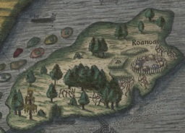
Roanoke

Slide 18
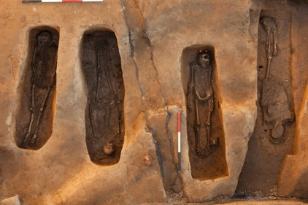
Jamestown

Slide 19
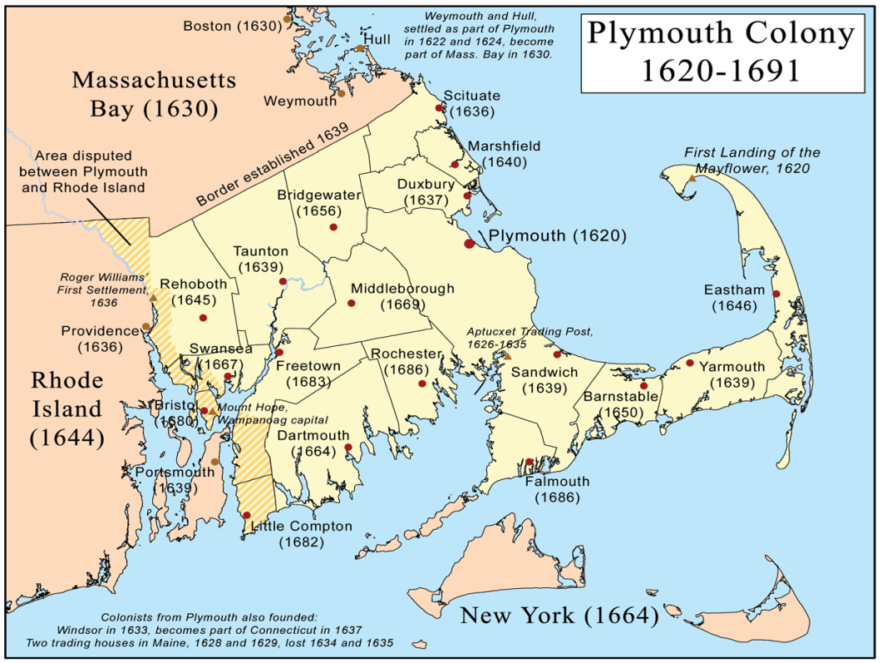
Piligrims

Slide 20
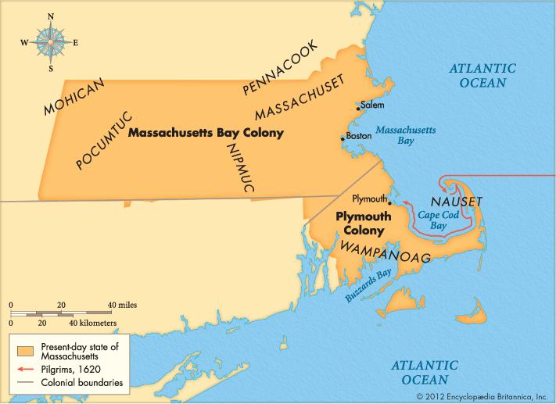
Purtians

Slide 21
New Netherlands

Slide 22
The Atlantic Slave Trade
What was the Atlantic slave trade
Why were slaves brought to the Americas
What sorts of plantations existed in the Americas
How did some African rulers participate in the slave trade
What kinds of trade included human beings
What was the triangular trade
What was life like for the slaves
How did Africans change in the Americas

Slide 23
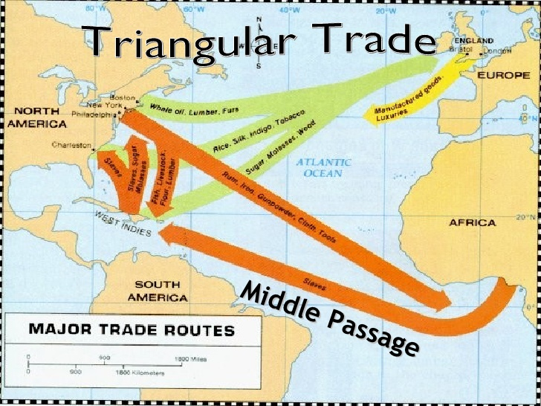
Triangular Trade

Slide 24
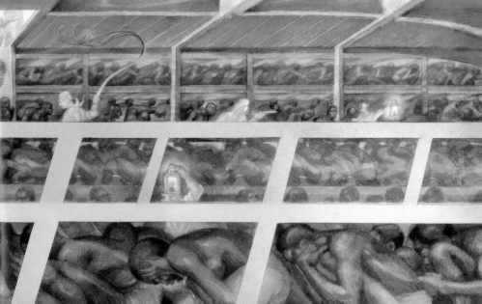
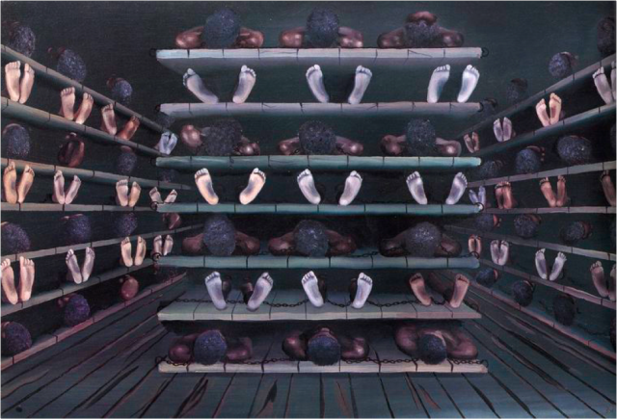
Middle Passage

Slide 25
Columbian Exchange and Global Trade
What was the Columbian Exchange
What did the Columbian Exchange take from the Americas, and what did it bring
How did business change
What is capitalism
Why were colonies important in mercantilism
What is mercantilism

Slide 26
Columbian Exchange
What things were exchanged between North America and Europe.

