Slide 1
England and France
How they developed and came to loath each other

Slide 2
2/9 Starter: Medieval Dangers
Name 8 different threats that you think people of the Medieval faced on a possible daily bases.

Slide 3
8 Dangers of the Medieval Period
1) Bad Weather
2) Heresy
3) Famine
4) Childhood
5) Childbirth
6) Violence
7) Hunting
8) Early Death

Slide 4
Terms and Names
William the Conqueror: Duke of Normandy who invades England in 1066 and claims the English crown
Henry II: English king who added French lands to English holdings by marrying Eleanor of Aquitaine.
Common Law: a body of rulings by English judges
Magna Carta: Great Charter, which guaranteed certain basic political rights.
Parliament: body of representatives that make laws for a nation, such in England.
Hugh Capet: founder of the dynasty that ruled France from 987-1328
Phillip II: One of the most powerful Capetian Kings
Estates General: a council of representatives that advise the French King.

Slide 5
Terms and Names
Avignon: City in France where the pope moved temporarily.
Great Schism: Division in the Church created by having popes in both Avignon and Rome.
John Wycliffe: English scholar who argued that the Bible was the final authority for Christian life.
John Huss: Bohemian scholar who taught that the Bible was the final word for Christian life
Bubonic Plague: deadly disease that spread across Asia and Europe in the mid 14th century.
Hundred Years’ War: War between England and France waged from 1337-1453
Joan of Arc: French peasant girl who led the French army to victory at Orleans.

Slide 6
Major Historical Events
1066: Battle of Hastings is fought.
1154: Henry II becomes king of England
1204: Phillip Ii of France gains Normandy from the English
1215: The Magna Carta is signed by King John of England.
1226: Louis IX becomes king of France
1295: Model Parliament meets during the reign of Edward I of England.

Slide 7
Major Historical Events
1305: The new pope moves to Avignon, where he leads the church
1328: The last Capetian king of France dies with no heirs. Edward III of England claims the throne.
1337: Edward III begins a war to win control of France.
1347: The plague starts making it way through Europe, lasts for decades.
1378: French pope dies and the Italians elect the next pope, while the French elect their own pope.
1429: Teenage peasant girl, Joan begins to lead France to victory.
1453: The Hundred’s Year War ends,

Slide 8
England Absorbs Waves of Invaders
Pages 393-394 in your textbook
Who invaded England?
Who is William the Conqueror?

Slide 9
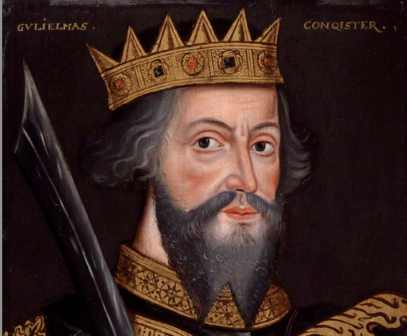
William the Conqueror

Slide 10
England’s Evolving Government
Page 394-395 in your textbook
What were some of England’s earliest steps toward democracy?
What brought about the creation and signing of the Magna Carta?
Why was the Magna Carta important?

Slide 11
English Monarchs
The Normans
William I “The Conqueror” reign: 1066-1087
William II “Rufus” reign: 1087-1100
Henry I reign: 1100-1135
King Stephen reign: 1135-1154
The Plantagenet
Henry II reign: 1154-1189
Richard I “The Lionheart” reign: 1189-1199
John reign: 1199-1216
Henry III reign: 1216-1272
Edward I reign: 1272-1307
Edward II reign: 1307-1327
Edward III reign: 1327-1377
Richard II reign: 1377-1399
Henry IV reign: 1399-1413

Slide 12
Kingdom of France Develops
Map handouts

Slide 13
Capetian Dynasty Rules
Pages 396-397 in your textbook
What was the Capetian Dynasty?
How did the kings of France gain more control over their subjects?

Slide 14
French Monarchs
House of Capet
Philip I reign: 1060-1108
Louis VI reign: 1108-1137
Louis VII reign: 1137-1180
Philip II reign: 1180-1223
Louis VIII reign: 1223-1226
Louis IX reign: 1226-1270
Philip III reign: 1270-1285
Philip IV reign: 1285-1314
Louis X reign: 1314-1316
John I reign: November 15-20, 1316
Philip V reign: 1316-1322
Charles IV reign: 1322-1328

Slide 15
French Monarchs
House of Valois
Philip IV reign: 1328-1350
John II reign: 1350-1364
Charles V reign: 1364-1380
Charles VI reign: 1380-1422

Slide 16
The Church Divided
How was the Church divided?
Pages 398-399
What does the city of Avignon have to do with the papacy?
When and how did the Great Schism begin?
Who are John Wycliffe and John Huss? What role do they plan?
How long did the Great Schism last?
When and how was the Great Schism resolved?

Slide 17
The Hundred Years’ War
Why was the Hundred Years War fought?
Pages 401-403
What was the primary reason for the war?
What new weapon is introduced during this war?
What role did Joan of Arc play in the Hundred Years’ war?
What was the outcome of the war?
What was the impact of the war on England and France?

Slide 18
Joan of Arc: Truth vs. Myth
Write down everything you know about Joan of Arc.
Now lets talk about some the myths of misconception about her.
Do you think your opinion matters about Joan of Arc’s voices? Why or why not?

Slide 19
End of Medieval Society
3 Factors
1. The Great Schism
How did the Great Schism affect medieval life?
2. Bubonic Plague
How did the plague affect the Church
3. Hundred Years’ War
How did the war affect medieval society?

