Slide 1
Trimiverate
A group of Three Rulers

Slide 2
First Triumvirate:

Slide 3
Julius Caesar, Gnaeus Pompeius and Marcus Crassus

Slide 4
“Assembled by Caesar himself, this trio formed the perfect balance of money, military might and political cunning.”
–Jonathan Hatfull

Slide 5
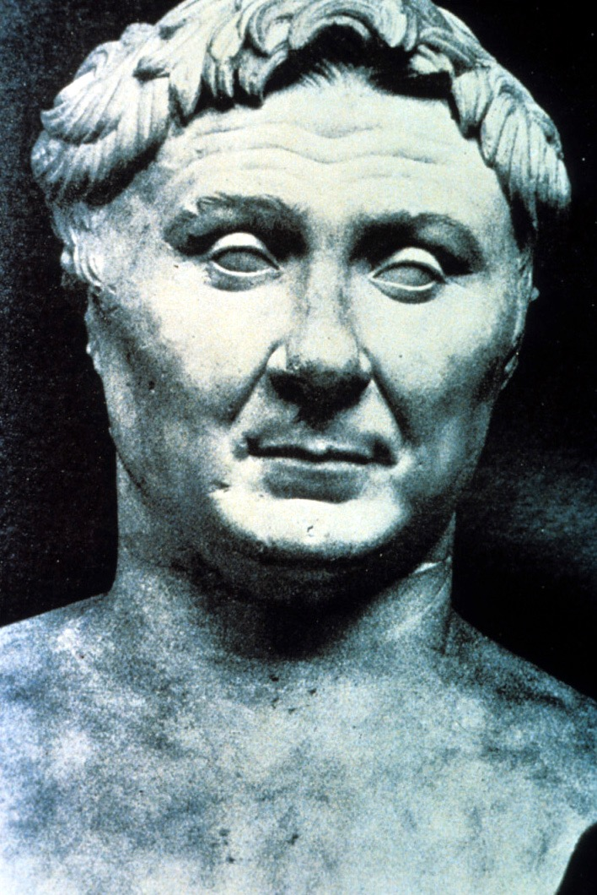
Gnaeus Pompeius
Pompey the great was a renowned general who had served under Sulla. However, he was chafing under the new regime since they had not fulfilled the promises he had made to his troops in Syria and Judea. He agreed to lend his muscle to Caesar’s campaign in exchange for the guarantee that Caesar would make him a governor once elected. The deal was sealed with the marriage of Pompey to Caesar’s daughter Julia and the general’s troops began strong-arming and intimidating Caesar’s opponents. However, once Caesar went to Gaul, Pompey quickly grew envious of his success and popularity.

Slide 6
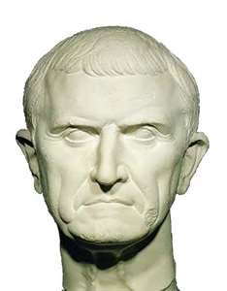
Marcus Crassus
Caesar needed financial support to run for consul and Crassus’s wealth was notorious. He’s amassed a huge personal fortune through underhanded real-estate dealings., his mining operations, as well as slavery. Crassus was in a position to bankroll Caesar’s military operations and to grease the palms of anyone who might be convinced to stand in his way. Once Caesar had convinced Crassus to overlook his long-standing rivalry with Pompey, the First Triumvirate had a bank. He would die fighting the Parthians, who reportedly poured molten golf into his mouth after executing him.

Slide 7
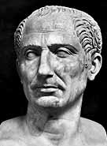
Julius Caesar
While Crassus gave the triumvirate gold and Pompey gave it military muscle, Caesar brought the political savvy and the ambition. The difficulty of reconciling two men who hated each other so bitterly should not be underestimated, but Caesar convinced them that the rewards he could give them through his consulship would far outweigh any petty rivalry. Once the First Triumvirate was formed, Caesar used brutal tactics to make sure he got what he wanted. The campaign he ran was so dirty that the famously honest Cato was forced to resort to bribery to make sure his son in-law was elected co-consul.

Slide 8
Caesar the Dictator
Throughout his regime, Caesar used the approval of the people to his advantage. When he returned to Rome have defeated Pompey, Caesar knew it was crucial to keep the people onside. Mistakes were make along the way though. When he celebrated his win over Pompey’s son in Spain, it was seen as a serious faux-pas as such festivities were reserved for victories over foreign foes, not the sons of former consuls.
His political reforms addressed some of the major concerns many had aired. He understood that, if Rome was to truly be an Empire, it could no longer hold back the benefits of living under Roman rule from those living outside Italy. With this in mind, he opened up citizenship to those living in Gaul, and encouraged people to relocate to the empire’s territories. He reduced debt and he ensured that soldiers who fought for him would have land to settle on. He was introduced a new calendar, aligning the months with the solar year rather than the Moon.
To ensure opposition against him in the Senate was minimal, Caesar expanded their ranks. Each position was now open to more candidate, making the aristocratic elite that opposed him less of a majority. Although he wore the purple robes of a king, sat on a throne in the Senate and had his face on the empire’s coins, Caesar was careful to keep up appearances that he was a duly elected official.

Slide 9
The Ides of March
March 15, 44 B.C.
Men with messages called at Caesar’s home that morning before he set out for the forum. Caesar did not have time to read the warnings. Marc Antony was detained outside the Senate House by Decimus Junius Albinius and so prevented from taking his usual place guarding Caesar. The conspirators’ planning was meticulous, as it needed to be.
These were the men who walked up with Caesar as he came into the Senate House and went towards his chair. He was surrounded by men asking questions, calling and waving papers. Another of the conspirators, Tillius Cimber, was the brother to a man Caesar had exiled and wanted him to be allowed to return to Rome. He was sure if Caesar was killed his brother would be free to come home. Caesar brushed the request aside as others pressed around him more urgently.
Tillius pulled his toga down at the neck. This was the signal to attack. Cassius stabbed Caesar in the neck and wounded him. Then the others closed in on him like animals in a pack. Whichever way he turned he took the blows of the blades and saw the steel aimed at his face and eyes. Driven this way and that like a rat in a trap the blows slashed and stabbed down. Each of the conspirators had sworn to blow their knives in Caesar’s body.
He fought them off the best he could, reeling from one to another until he saw Brutus, whom he had loved and trusted. Brutus came in close with his bare blade and Caesar said “Et tu Brute”. Caesar then drew his toga over his head as he would when sacrificing at an altar and took Brutus’s blade in his groin. In all he took 23 wounds and died as Senators turned and ran leaving the conspirators reeking of Caesar’s blood.

Slide 10
“Friends, Romans, Countrymen, lend me your ears; I come to bury Caesar, not to praise him. The evil that men do lives after them; the good is oft interred with their bones; So let it be with Caesar. The noble Brutus hath told you Caesar was ambitious: If it were so it was a grievous fault; and grievously hath Caesar answer’d it. Here under leave of Brutus and the rest, for Brutus is an honorable man, So are they all, all honorable men, Come I to speak in Caesar’s funeral. He was my friend, faithful and just to me: But Brutus say he was ambitious; and Brutus is an honorable man. He hath brought many captives home to Rome, whose ransoms did the general coffers fill: Did this in Caesar seem ambitious? When that the poor have cried, Caesar hath wept: Ambition should be made of sterner stuff: Yet, Brutus say he was ambitious; and Brutus is an honorable man. You all did see that on the Lupercal I thrice presented him a kingly crown, Which he did thrice refuse: was this ambition? Yet Brutus says he was ambitious; and, sure, he is an honorable man. I speak not to disprove what Brutus spoke, but I am to speak what I do know. You all did love him once, not without cause: What cause withholds you, then, to mourn O judgement, thou art fled to brutish beasts, and men have lost their reason! Bear with me; my heart is in the coffin there with Caesar, and I must pause till it come back to me.”
- Marc Antony in Shakespeares Julius Casesar

Slide 11
Second Triumvirate

Slide 12
Marc Antony, Octavian and Lepidus

Slide 13
“In November, Antony, Octavian and Lepidus met and put aside their enmity to form the Second Triumvirate.”
–All About History

Slide 14
The goal of the second triumvirate was two-fold:
1. Avenge the murder of Julius Caesar by hunting down the conspirators
2. Work together to rule the Roman Empire.

Slide 15
Who wins
Which member of the Second Triumvirate become Emperor?

