Slide 1
The Great Depression
America in the 1930’s
7th Period’s Perspective

Slide 2
How did it start?
The Crash of 1929
2/19 Starter:
What was the main cause of the Crash of 1929 and what did it start within American society?

Slide 3
Herbert Hoover
Born in Iowa in 1874 and grew up in Oregon
Son of a Quaker blacksmith
He had a reputation as a public servant as an engineer, administrator and humanitarian
Went to Stanford University
Married his Stanford sweetheart Lou Henry
Lived in China until the Boxer Rebellion in 1900
Lived in London at the time Germany declared war on Britain in 1914

Slide 4
As President
“Rugged Individualism”
“One of the great problems of government is to determine to what extent the Government itself shall interfere with commerce and industry and how much it shall leave to individual exertion… By adherence to the principles of… opportunity and freedom to the individual, our American experiment has yielded a degree of well-being unparalleled in all the world”

Slide 5
Nation’s Response to Hoover
He loses favor and people lose faith in his ability to help
Bonus March
The voters react in both the 1930 midterm election and 1932 presidential election.

Slide 6
Franklin Delano Roosevelt
Born is Hyde Park, New York in 1882
Attended Harvard and Columbia University
Married his second cousin Eleanor in 1905
Summer of 1921 he comes down with polio, a disease that destroys the nerves and is considered a childhood disease.
He is determined to walk again and works hard to exercise is legs through swim and water exercising.

Slide 7
Franklin Delano Roosevelt
He made appearance on crutches at the 1924 Democratic Convention, after that he was always seen holding on to someone’s arm or using a cane to balance himself.
He never wanted to people to think that he was incapable of accomplishing anything due to his “handicap”

Slide 8
Franklin Delano Roosevelt: Accomplishments as President
New Deal
Executed programs designed to provide the unemployed with government jobs
Agencies such as the AAA, CCC, REA, WPA, TVA, SEC, FDIC, NRA, and FSA
Repealed Prohibition
Helped him win the next election
Eventually the gross national product went up to 34%
Unemployment went from 25% to 14%
Established the Good Neighbor Policy with Latin America in place of the Monroe Doctrine
Was elected for a third and fourth terms. Served as president from 1933-1945
Felt he was the most fit to lead the country during the war

Slide 9
Pros and Cons
Pros
Lead America through the worst economic crisis yet.
Helped Great Britain, Chinese Nationalists and the Soviet Union fight the Axis Powers
Ronald Reagan often mentioned and quoted FDR
Cons
Critics say he centralized power around himself
Controlled government and democratic party
Court packing incident of 1937
Ran for more than the traditional 2 terms.
People disagree with government planning of the economy
Got America involved in War

Slide 10
How did government change?
Went from hands off to more hands on
Become aware of and tried to help those American citizens who were suffering
Also grew in size with the new agencies.
Helped more with public works and improvements.

Slide 11
What happened to the people?
People lost:
Their jobs
Their life savings
Their homes
Their dignity

Slide 12
Economic Problems
Crash of 1929
Bank Failures of the 1930s
Crop failures and drought
Business lay off up to 25% of the American workforce

Slide 13
Music of the Day
The Music industry was affected by the depression
Sales declined from 100 million in the 1920’s to just 10 million dollars in sales
However the development and popularity of the radio also cause an expansion of American exposure to music, as the radio was one of the only consumer products that people would work to keep.

Slide 14
Genres
There was a wide variety of music available at the time.
Anything from Broadway show tunes, Jazz, Blues, Swing, Protest, Folk and Classical.
The key to the music was two fold:
First bring the problems of the American people to the public conscience.
Second, to give the millions of Americans without hope, the hope that things would get better.

Slide 15
Songs
There were a variety of songs but we are going to look at a Protest Song by Billie Holliday
“Strange Fruit”
https://www.youtube.com/watch?v=h4ZyuULy9zs
Let’s compare it to a modern popular protest song.
“The Hanging Tree”
https://www.youtube.com/watch?v=aJISG67FjeM

Slide 16
Lyrical Comparison
What is “Strange Fruit” talking about?
What is “The Hanging Tree” talking about?
Are similarities in their tone and message? If so what are they?
Are there differences? If so what are they?
Does the music of the 30’s still influence our music today?

Slide 17
Social Problems
Segregation is still a big part of American Society at this time.
With the economic and political issues of the day, Jim Crow becomes in more enforces and southern lynching become even more prevalent.
Listen to Billie Holliday one more time and see if you can see southern society of the 30’s.
https://www.youtube.com/watch?v=98CxkS0vzB8

Slide 18
Social Problems
These problems were not just in the south. As people fled the dust bowl, many went to California to find work in the industry they knew best, farming.
We are going to watch a segment from Ken Burn’s the Dust Bowl about the experiences of Migrate families.

Slide 19
Fashion
The fashion of the day was very practical and yet glamorous at the same time.
Women who could afford to wore dresses that were simple and yet chic.
Shoes were focused more on a simple heel with a possible peep toe.
Hats were still important and while they may not be a decorative as in the past, the simple was still glamorous with its simple ribbon accents.

Slide 20
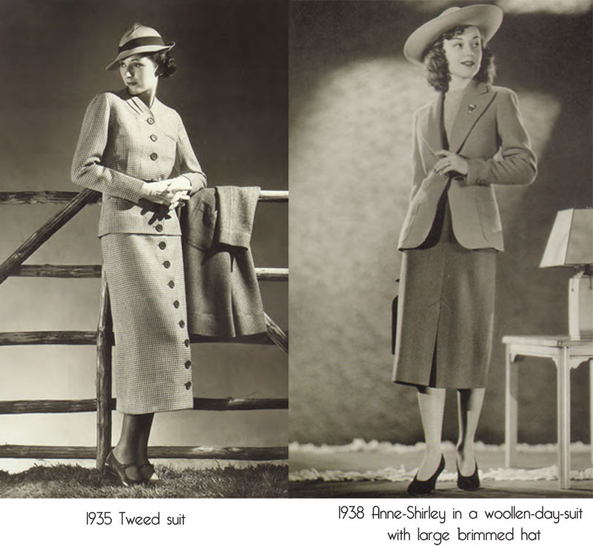
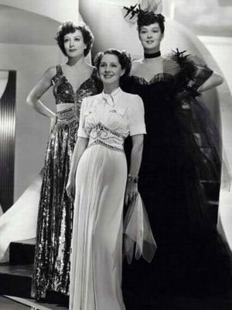
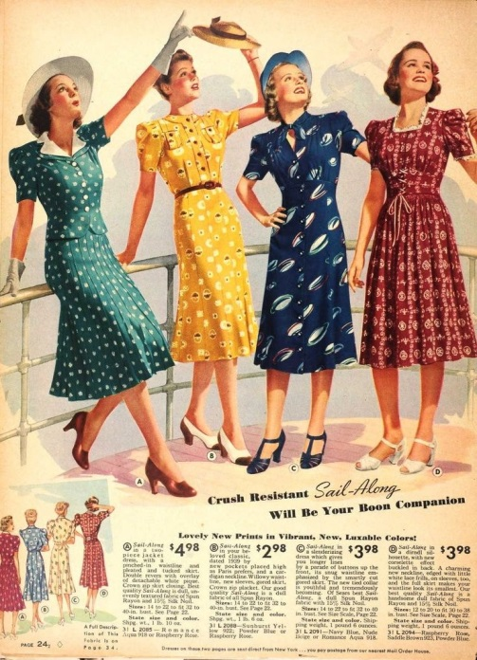
Fashion

Slide 21
Beauty
Beauty was all about Hollywood glamor and looking like the starlets of the time including: Greta Garbo, Katherine Hepburn and others.
They all have their signature look but also had commonalities such as thin eyebrows and long luxurious eyelashes.
Hair was curls and either pinned up or bobbed short like the 20s.

Slide 22
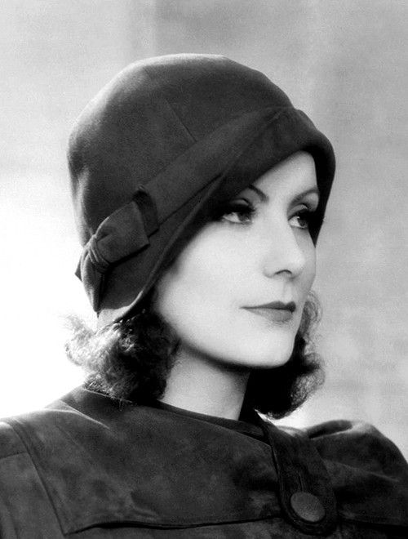
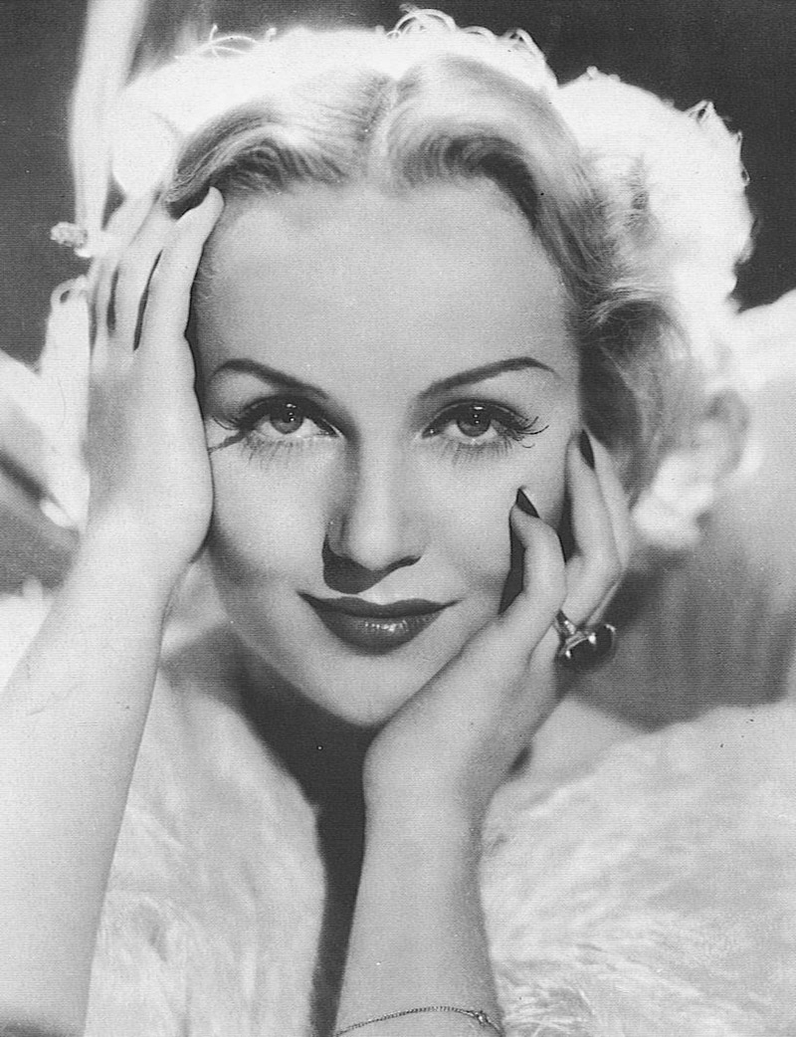
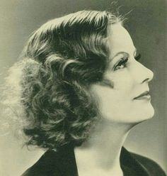
Beauty

Slide 23
Men’s Fashion
Very slick, simple and clean cut.
All respectable men wore hats, mostly fedoras
Every man whether a blue collar or white collar worker wore slacks and button down shirt outside of work.
Jeans and overalls were worn for more labor intensive work such as farming
Shoes were all made of leather whether more of a loafer type or a boot.
Men kept their hair cut short and the clean shaven look was more in than the beards of the 19th century or the mutton chops of the early 20th.

Slide 24
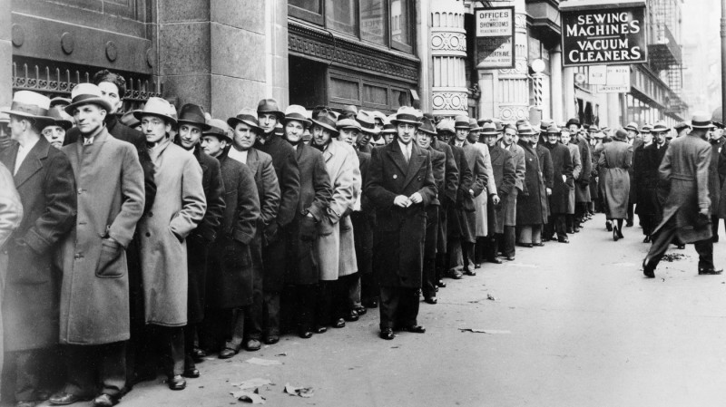
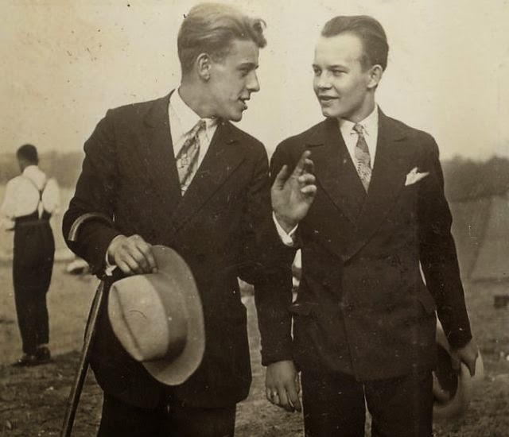
Men’s Fashion

Slide 25
Sports in the 1930’s
Baseball
Olympics of 1936

Slide 26
Dance
Many of the social dances of the 1920’s continued but people look to dance competitions as a way to gain fast money.
These competition would last anywhere from 24 hours to days at a time and the prize money would go to the last couple standing.
These were called dance marathons
https://www.youtube.com/watch?v=5yaY-Qk9nIs

Slide 27
Film
The film industry tried to bring hope and an escape to the people who could afford the price of a ticket with films like:
The Wizard of Oz
Gone with the Wind
Shirley Temple Films
https://www.youtube.com/watch?v=fbtR1DNgNak

Slide 28
Photography
FSA- Farm Security Administration
One of the new deal programs that hired famous phtographers to document the Great Depression through photography
The goal was to show the public and Congress the full extend of the problems that FSA was trying to solve
Built a collection of more the 80, 000 photographs of the Great Depression
One of these photographers was Dorothea Lange.

Slide 29
Dorothea Lange
Her photographs of the Great Depression made her one of the most famous photographers of the 20th Century.
Focused on the unemployed, migrant workers and homeless
Has influenced documentary and journalistic photography of today.
http://www.livinghistoryfarm.org/farminginthe30s/water_14.html

Slide 30
Literature

Slide 31
How did it end?

Slide 32
How do we view the Great Depression today?

