Slide 1
The Rebirth of Humanity
The Italian Renaissance

Slide 2
Terms and Names
Renaissance: Period of rebirth of art and learning in Europe from 1300 to 1600.
Humanism: focus on human potential and achievements.
Secular: concerned with worldly rather and than spiritual matters
Patrons: people who financially supported artists.
Vernacular: use of native language instead of classical Latin.

Slide 3
Terms and Names
Utopia: an ideal place
William Shakespeare: Famous Renaissance writer.
Johann Gutenberg: German craftsman who developed the printing press.

Slide 4
Major Players in the Renaissance
Writers
Petrarch
Boccaccio
Machiavelli
Artists
Da Vinci
Michelangelo

Slide 5
Italy’s Advantages
Why did the Renaissance begin in Italy?
Read pages 471-472
What are three reasons why the Renaissance began in Italy?

Slide 6
Italian City States: Renaissance Florence
1. A Booming Economy: During the Renaissance, Florence enjoyed a healthy and growing economy, becoming the most important-city state in Italy. Merchants transformed a local wood industry into an international business, and even the lower classes felt the benefit.

Slide 7
Renaissance Florence
2. The birth of modern cuisine: The wealthy residents of Renaissance Florence were inspired by the Medici family to enjoy a variety of new, exciting foods. Potatoes and peppers became important ingredients and the fork gained popularity as a utensil.

Slide 8
Classical and Worldly Values
What new values did people hold?
Read pages 472-473
What are secular ideas?
What is humanism?
How does humanism influence the growth of learning?
Did ideas about piety and a simple life change?

Slide 9
Renaissance Revolutionizes Art
How did art change during the Renaissance?
Read pages 474-475
How did the methods and subjects in art change?
What role did patrons of the arts play in the development of the Renaissance?
What effects did the emphasis on individuals have on painters and sculptors?

Slide 10
The Great Masters
http://mrsjuliajanewinslow.weebly.com/quarter-3-assignments1.html
Da Vinci
http://legacy.mos.org/leonardo/
Michelangelo
http://www.michelangelo.org/

Slide 11
Renaissance Writers Change Literature
How did literature change during the Renaissance?
Read pages 475-477
What did Renaissance writers write about?
How did writers reflect Renaissance values in their work?
How did the writing of Petrarch, Boccaccio and Machiavelli demonstrate the values of humanism?

Slide 12
Sample of Renaissance Writing
Machiavelli’s The Prince, 1513
Concerning Cruelty and Clemency, and whether it is better to be loved than feared.
With a partner read through Machiavelli’s words and discuss whether you agree with him or why you disagree with him. Give examples from the text to support your answer. Each partnership needs to write 8 sentences supporting their stance on Machiavelli.

Slide 13
Northern Renaissance Begins
Why was the time right for the northern Renaissance to begin.
Read page 480
What factors led to the beginning of the Renaissance in northern Europe?
How was the northern Renaissance different from the Renaissance in Italy?

Slide 14
Artistic Ideas Spread
What ideas about art developed in northern Europe?
Read pages 480-481
What did the northern European artists paint?

Slide 15
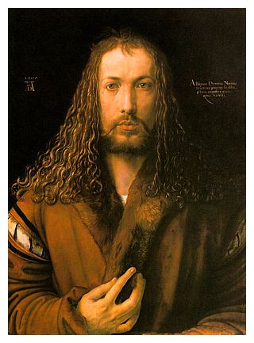
Northern Artists
Albrecht Dürer

Slide 16
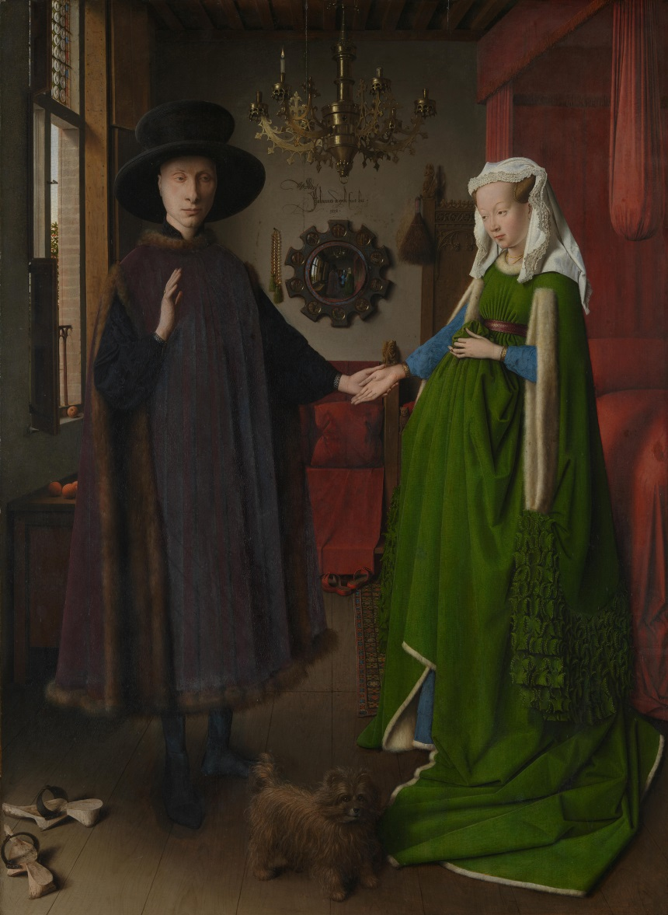
Northern Artists
2. Jan van Eyck

Slide 17
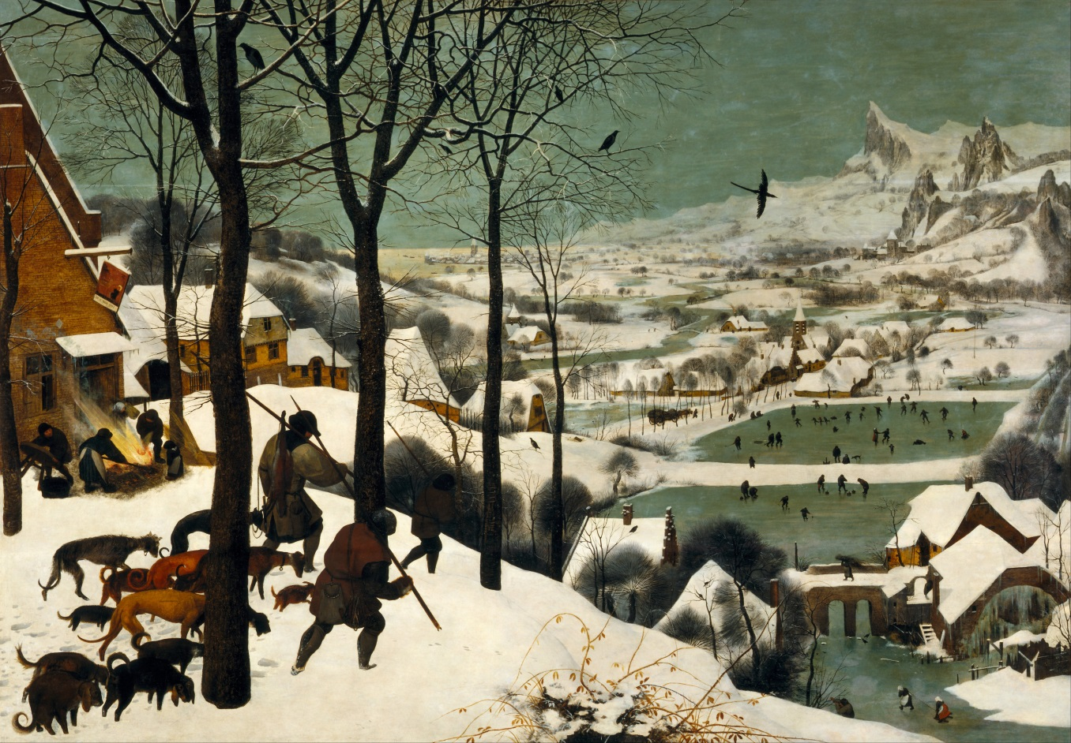
Northern Artists
Pieter Bruegel the Elder

Slide 18
Northern Writers Try to Reform Society; The Elizabethan Age
What did northern writers write?
Read pages 482-483
Who were two of the most famous writers of the northern Renaissance?

Slide 19
Northern Writers
Desiderius Erasmus
Thomas More
William Shakespeare

Slide 20
Erasmus Quotes
Each of you is going to be handed a quote or saying from Erasmus.
You will need to find someone else in the room who has a different quote.
You will need to explain to your partner what you think your quote means.
You will have five turns and must talk to five different people.

Slide 21
Printing Spreads Renaissance Ideas; The Legacy of the Renaissance
Why was the printing press such an important development?
Read pages 484-485
How did the invention of the printing press help spread learning and Renaissance ideas?
What effects did the printing press have on the northern European life?

Slide 22
Role of the Printing Press and the reformation
We are now going to begin watch a video about the power of the printing press and the Reformation.
You will each get a worksheet to fill out. Please watch and listen carefully and answer the questions as truthfully as you can.
Your grade will be based on how many questions you answer correctly. Each question is worth 2 points.

