Slide 1
World War II
How the world was brought to the brink of war again.

Slide 2
Leadership
What skills are needed to be a great leader?
Let’s make a list:

Slide 3
How do leaders gain support
Tell people what they want to hear.
Examples
Historical
Modern Day
Tell people what they need to hear.
Historical
Modern Day

Slide 4
When are strong leaders needed?
Let’s list some times in history or even just in life.

Slide 5
At what point does a leader become dangerous?
Let’s list some actions that dangerous leaders have taken.
How would these actions define a leader who has become dangerous.

Slide 6
Whose Responsibility is it to make sure a leader does not go to far?
The people?
Government?
Society?
International Community?

Slide 7
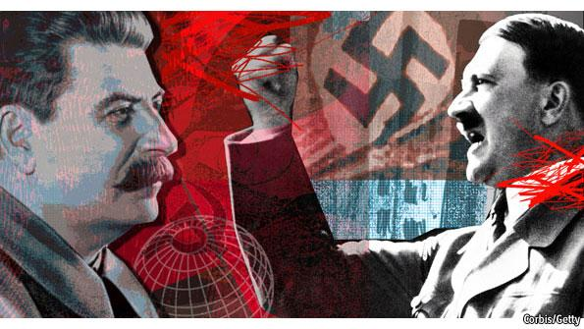
What is a dictator?
A person or group who has complete control of both government and society.
Whose needs/goals are forced to become the needs/goals of the entire nation.

Slide 8
Why do dictators come to power in the 1920’s and 1930’s?
The Great Depression is a world wide problem
Countries through the world are suffering the effects of World War I as well.
Out the need for strong leadership countries chose or are forced into dictatorships.

Slide 9
In the time period there are 3 main choices for government.
Democracy
Communism
Fascism
Can you give me an historical example of each?

Slide 10
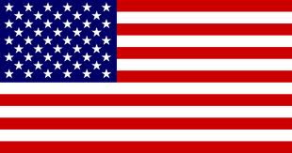
Government of Democracy
Controlled by the people.
Check and balances
Right to question government authority
For the benefit of the people.
Ran by the people.
Anyone can run for political office

Slide 11
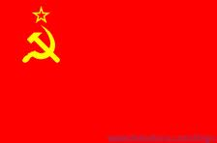
Government of Communist
Controlled by the State
For the benefit of the everyone
Ran by the state or people?

Slide 12
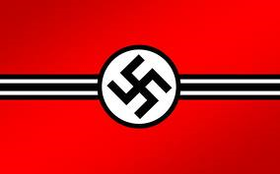
Government of Fascism
Controlled by the state
For the benefit of the State
Ran by the State

Slide 13
The World after WWI
What was happening during the 1920’s and 1930’s

Slide 14
Japan
Spent 1900-1920 industrializing.
With the help of the United State
By 1920 is major world industrial power
By 1930 is running out of Resources
Some Japanese leaders feel that they are being disrespected by “Western Nations” and feel a need to prove themselves.

Slide 15
France
Very bad economy
Environment still recovering from WWI
Economy is in a huge depression because of WWI and is made worse by the United States Depression and Smoot Hawley Tariff Act.
Angry at Germany for WWI and starts to build up a defense along the Germany border on the Maginot Line.

Slide 16
Great Britain
Economy is in a huge depression because of WWI
Made worse by United States Depression and Smoot Hawley Tariff Act.

Slide 17
Italy
Economy is in a huge depression because of WWI
Made worse by United States Depression and Smoot Hawley Tariff Act.
Angry with League of Nations because they feel they deserved new territory for participation in WWI

Slide 18
United States
Did not join the League of Nations
The Roaring 20’s
October 29, 1929 Crash of the Stack Markey, Black Tuesday
1930’s THE GREAT DEPRESSSION

Slide 19
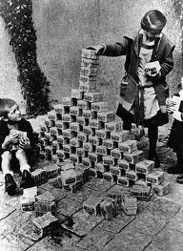
Germany
Economy is non-existent
Why?
Reparations for WWI (War Guilt Clause)
1919 1 U.S. dollar = 9 deutschmarks
1923 1 dollar = 4,000,000,000,000 deutschmarks
Caused by hyperinflation due to printing too much money in higher increments in order to pay the war debt.
Thought it would hurt the Allies economies, ended up hurting their own economy more.

Slide 20
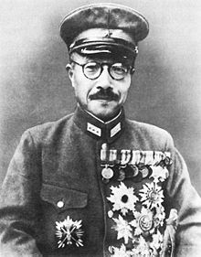
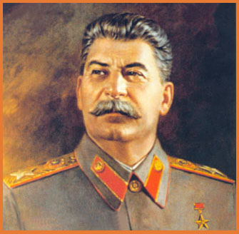
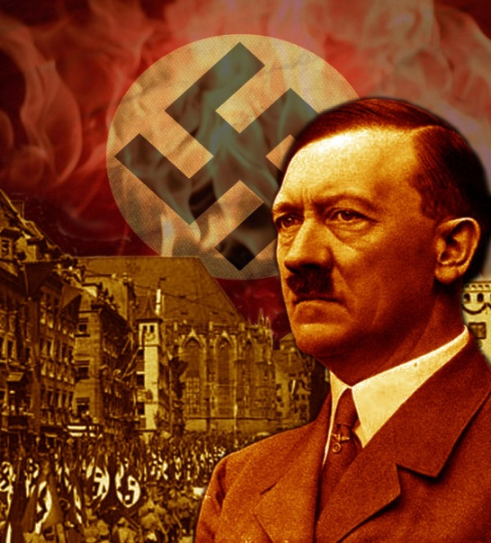
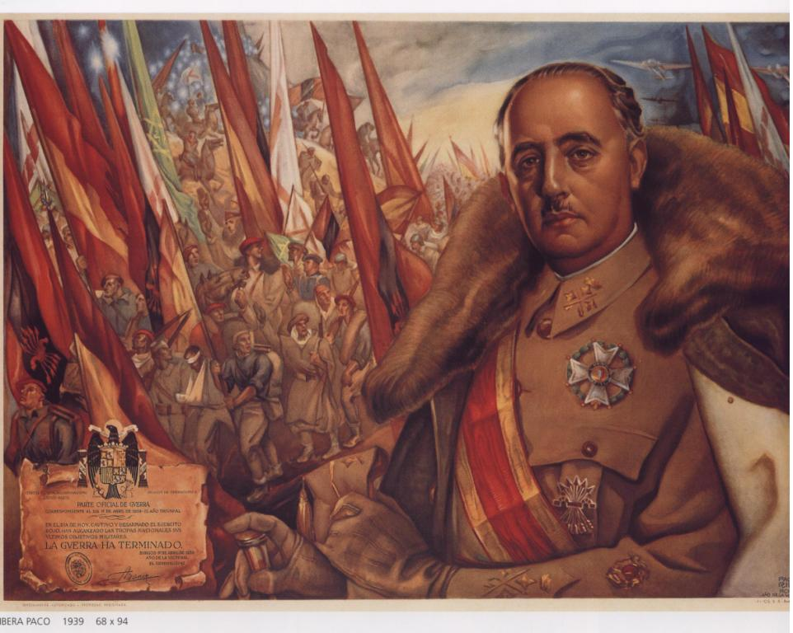
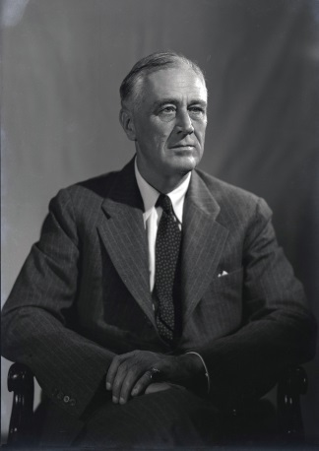
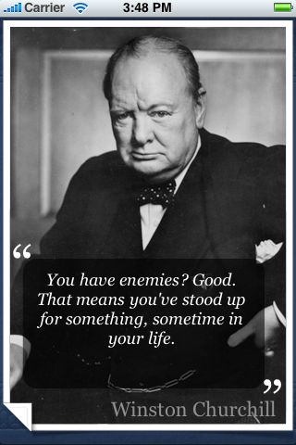
Rise of Dictators and the Major Characters of WWII

Slide 21
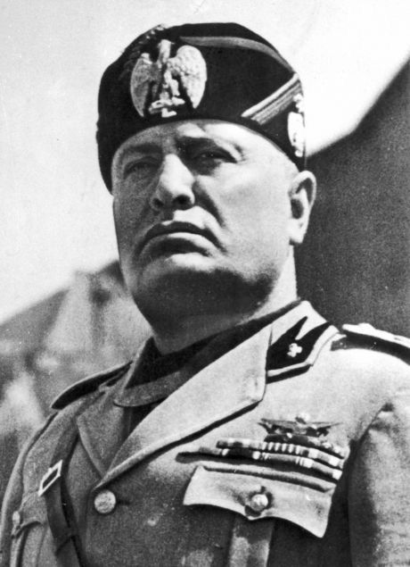
Italy
Benito Mussolini
Il Duce- The leader
He was communist in his early political career.
After WWI he was angry because he through Italy was too weak and therefore not respected by other European Nations
He changes to a Fascist

Slide 22
Mussolini
Skills- very intimidating and great orator
Remember he can speak Italian, French, German and English (clip from last time)
1922 elected to office and then becomes dictator of Italy
Policies as Dictator
No Political Parties
Kills Communists
Controls news and schools through state propaganda

Slide 23
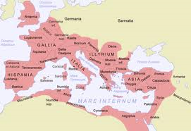
Mussolini’s Goal
Wants to rebuild the Roman Empire

Slide 24
Germany
Adolf Hitler- Führer- Leader
Background
Born in Austria into an average family
As a boy he had two interests
Art and the military
He was rejected by the Vienna school of Art and Austrian society as a whole as an artist.
Develops a depressed, angry, anti-social attitude.

Slide 25
Hitler
Found acceptance through a group of people who teach him about the idea’s of Anti-Semitism (hatred of Jews)
1914- WWI starts and Hitler moves to Germany and joins the Army, he almost dies and spends the last few months of the war in the hospital
1918- WWI ends and Hitler stays and joins the small political party called: The National Socialist Workers Party (NAZI)
1923- Germany is in a huge depression, Hitler leads a small revolt against the German government, Beerhall Putsch in Munich. He is caught and arrested.

Slide 26
Hitler’s Goals
While in prison he write a book Mein Kompf, “My Struggle”. In this book he states his goals.
His book teaches about:
Creation of a pure Aryan Race
Anti-Semitism and Jewish extermination (they are the anti-race)
Racial pyramid.
Goal to build a 3rd Reich or Rule of Germany
Rebuild the Holy Roman Empire
Become the most powerful person/nation in the world

Slide 27
Hitler Comes to Power
Skills- great speaker and master manipulator, plays on existing prejudices within society
Tells people what they want hear, he get elected in 1934
Uses fear, violence and manipulation to take control of the government and creates a Nazi dictatorship with his SA and SS soldiers along with the Gestapo to suppress all resistance.

Slide 28
Spain
1936- The Spanish Civil War, Communists versus Nationalists (Fascists)
Soviet Union and the United States help out the Communists
Germany helps the Fascists
1939- Fascists win and Francisco Franco becomes the new dictator of Spain
Signs a treaty with Hitler agreeing to help Germany in their goals.

Slide 29
Japan
Hideki Tojo
1920- Japan is running out of natural resources
Some Japanese people start teaching the idea of a “Pure” Asian Race based on Japanese Ideals
1931- Military leaders overthrown the Japanese government and make plans to invade Manchuria and China for natural resources
Some military leaders like Tojo are upset with the government’s reliance on Western nations like the United States for resources such as steel..
1931- United States (Japan’s biggest trading partner) begins to boycott the new Japanese government.
1933- Tojo signs a Treaty with Germany

Slide 30
Japan’s Goals
Create a “Pure” Asian race based on Japanese ideals
Force non-Japanese Asians to become subject to Japanese rule
Get natural resources to continue to industrialize and maintain power.

Slide 31
Soviet Union
Joseph Stalin
1920- he comes to power when Vladimir Lenin dies
Stalin believe himself to be the greatest leader in human history and uses propaganda to get Soviets to follow him
Puts pictures of himself everywhere and even renames Moscow Stalingrad.
Stalin dominates all areas of soviet life.

Slide 32
Stalin
Kills all opponents of himself and communism
An anti-Semite
Under his rule 25 to 60 million of his own people are going to die in gulags (worse than Hitler)
Forced removal to Siberia
Murder
Starvation

Slide 33
Stalin’s Goals
Be the greatest ruler and nation in the world
Create a buffer between western Europe and eastern Europe
Spread Communism throughout the world

Slide 34
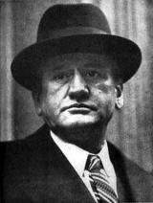
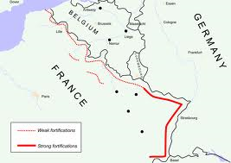
France
Edouard Daladier
Goals
Keep peace at all costs
End the economic depression in France
Fortify the Maginot Line in eastern France.

Slide 35
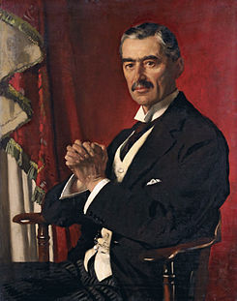
Great Britain Pre-1940
Nevel Chamberlain
Goals
Keep peace at all costs
End the economic depression in Great Britain

Slide 36
Great Britain in 1940
Winston Churchill
Comparable to FDR in Power and Teddy Roosevelt in Personality
Background
Independent
Rebellious to authority
Strong moral character

Slide 37
Winston Churchill
As a military man experienced fighting in:
Cuba (Spanish American War)
India (Fighting Gandhi and Indian Rebel Army)
South Africa (Fighting South African Army)
World War I

Slide 38
Churchill’s Goals
The Nazi’s and Hitler must be stopped at all costs.

Slide 39
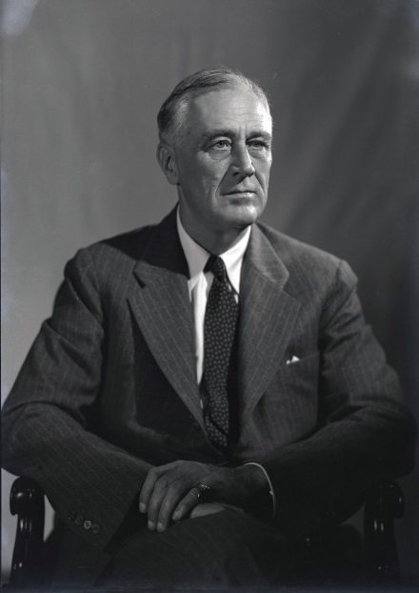
United States
Franklin Delano Roosevelt
Wins the 1940 Election, his 3rd term, because the nation wants a strong leader in case the war in Europe comes to America.
In a 1939 poll 97% of American think Germany is dangerous, in the same poll 97% of American want to stay out of “European War”.
Goal “This is Europe’s War”
Isolationism, but helps Allies like France and Britain (Same as World War I)

Slide 40
Causes of WW II
Economic depression
Rise of dictators
Appeasement by the League of Nations
The Treaty of Versailles did not allow
Germany to have a large Army
Germany to expand territory
Germany to have Allies

Slide 41
What is Appeasement?
Giving into aggressive or violent demands to keep peace.
What is the result of Appeasement?

Slide 42
Appeasement of dictators
What happens when aggressive behavior is allowed.

Slide 43
Italian Expansion before the War
1935: Mussolini invades Ethiopia
1936: Ethiopia askes the League of Nations for help to stop Mussolini.
League of Nations Appeasement to Mussolini
1939: Mussolini and Hitler become allies
League of Nations Appeasements of both Mussolini and Hitler

Slide 44
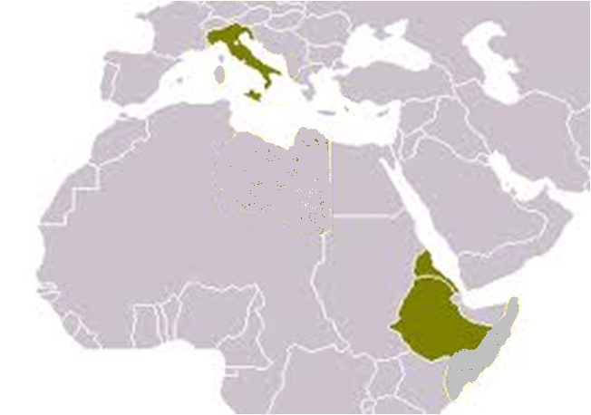
Italian Expansion before the war.

Slide 45
Japanese Expansion before the war
1931: Japan attacks Manchuria
League of Nations Appeasement
1937: Japan attacks China
League of Nations Appeasement
1937: Massacre at Nanjing kills 300,000 civilians
League of Nations Appeasement

Slide 46
Japanese Expansion before the war
1938: Japan attacks southeast Asia and takes control of Laos, Vietnam and Cambodia.
League of Nations Appeasement
1938: Japan attacks the Philippines
League of Nations stops trading with Japan
1940: Japan and Germany become Allies
Japan joins WWII on the side of the Axis Powers

Slide 47
Japanese Expansion before the war.

Slide 48
German Expansion before the war.
1938: Hitler threatens to take over Chechoslovockia.
League of Nations, Neville Chamberlain convinces Chechoslovockia to allow Germany to take it over to avoid war.
1939: Hitler makes an alliance with Mussolini
League of Nations Appeasement
1939: Hitler makes a treaty with Stalin and states “I have the world in my pocket”
League of Nations Appeasement
August 31, 1939:
Hitler dresses a German criminal like a Polish solider and has him shot by German/Poland border.
Claims Poland attacked Germany

Slide 49
German Expansion before the war.
1933: Hitler begins militarizing Germany
League of Nations Appeasement
1936: Hitler send troops into the Rhineland to protect border against France.
League of Nations Appeasement
1938: Anschluss, Hitler takes over Austria-Hungry without a fight.
League of Nations Appeasement

Slide 50
German Expansion before WWII
August 31st, 1939
Hitler dresses a German criminal like a Polish solider and has him shot by the Germany/Poland border.
He claims Poland attacked Germany.
Declared war on Poland.
Poland has no natural boundaries or modern military
i.e. swords and horses vs. tanks and machine guns.
Hitler takes control of Poland.
September 3rd, 1939 the League of Nations declares war on Germany.

Slide 51
German expansion before the War.

Slide 52
Axis Powers Pre-WWII

Slide 53
September 3rd, 1939
World War Two has started!
Reflect on the following questions:
Did it need to?
If so why did it?
What could have been done to prevent it?

